Slide 1
Chapter Thirteen
Cost Curves
成本曲线

Slide 2
Structure
Types of cost curves
  Fixed, variable and total cost functions
  Average fixed, average variable and average cost functions
Marginal cost functions
Marginal and variable cost functions
Marginal and average cost functions
Short run and long run cost curves

Slide 3
Types of Cost Curves
A total cost curve （总成本曲线）is the graph of a firm’s total cost function.
A variable cost curve （可变成本曲线）is the graph of a firm’s variable cost function.
An average total cost curve （平均成本曲线）is the graph of a firm’s average total cost function.

Slide 4
Types of Cost Curves
An average variable cost curve （平均可变成本曲线）is the graph of a firm’s average variable cost function.
An average fixed cost curve （平均固定成本曲线）is the graph of a firm’s average fixed cost function.
A marginal cost curve （边际成本曲线）is the graph of a firm’s marginal cost function.

Slide 5
Types of Cost Curves
How are these cost curves related to each other?
How are a firm’s long-run and short-run cost curves related?

Slide 6
Fixed, Variable & Total Cost Functions
F is the total cost to a firm of its short-run fixed inputs （固定投入）. F, the firm’s fixed cost, does not vary with the firm’s output level.
c_{v}(y) is the total cost to a firm of its variable inputs （可变投入）when producing y output units. c_{v}(y) is the firm’s variable cost function.
c_{v}(y) depends upon the levels of the fixed inputs.

Slide 7
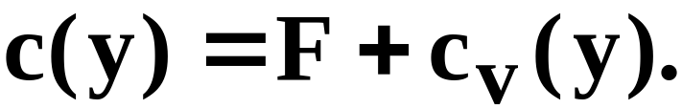
Fixed, Variable & Total Cost Functions
c(y) is the total cost of all inputs, fixed and variable, when producing y output units. c(y) is the firm’s total cost function;

Slide 8

$
F
y

Slide 9
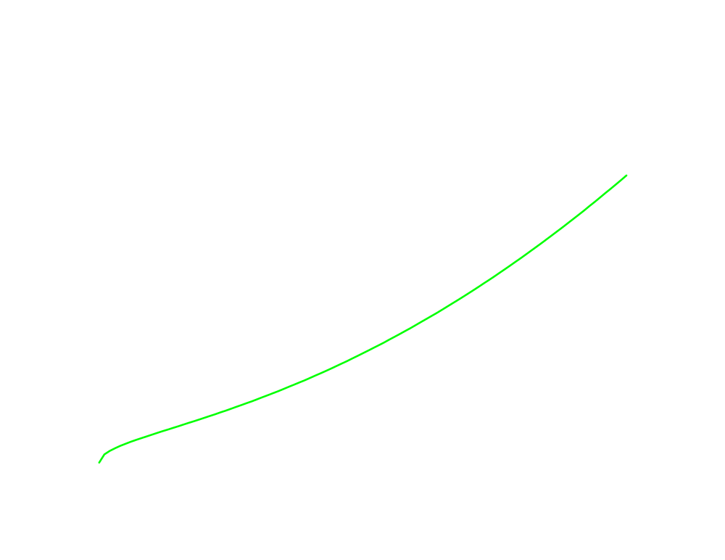
$
c_{v}(y)
y

Slide 10
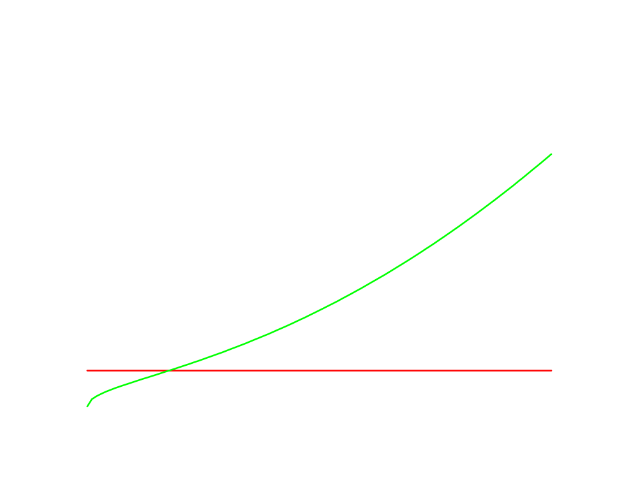
$
c_{v}(y)
F
y

Slide 11
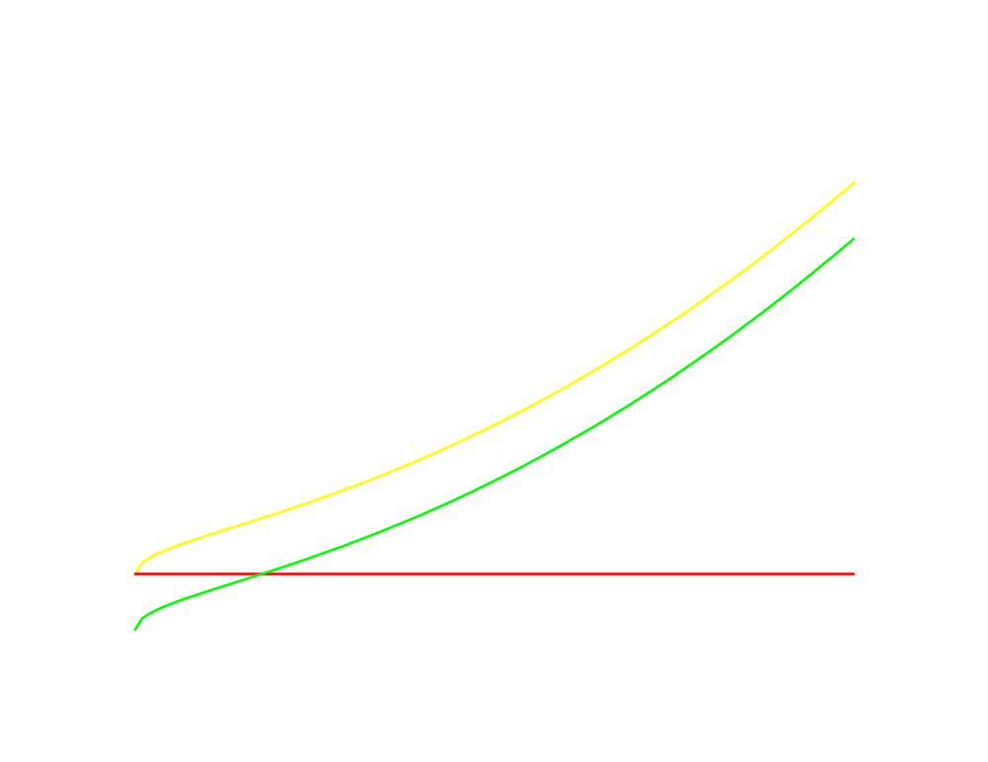
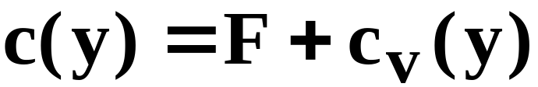
$
c(y)
c_{v}(y)
F
F
y

Slide 12
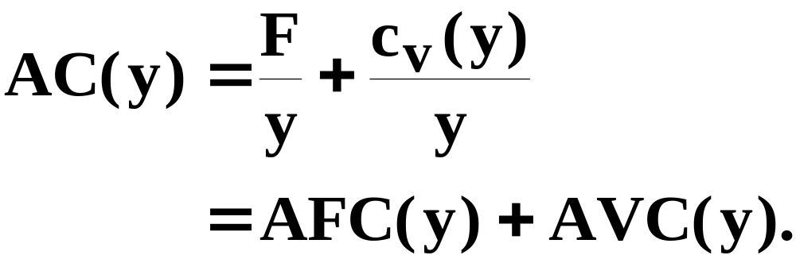
Av. Fixed, Av. Variable & Av. Total Cost Curves
The firm’s total cost function is
For y > 0, the firm’s average total cost function is

Slide 13
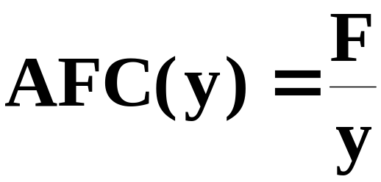
Av. Fixed, Av. Variable & Av. Total Cost Curves
What does an average fixed cost curve look like?
AFC(y) is a rectangular hyperbola so its graph looks like ...

Slide 14
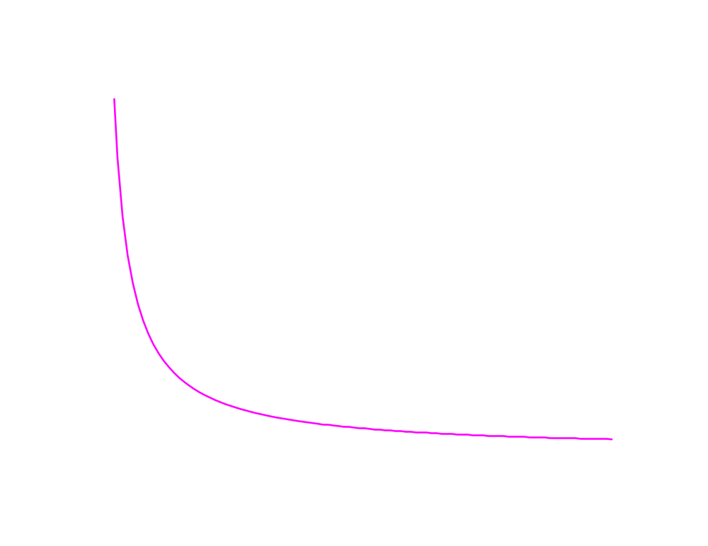
$/output unit
AFC(y) → 0 as y → ∞
AFC(y)
0
y

Slide 15
Av. Fixed, Av. Variable & Av. Total Cost Curves
In a short-run with a fixed amount of at least one input, the Law of Diminishing (Marginal) Returns must apply, causing the firm’s average variable cost of production to increase eventually.

Slide 16

$/output unit
AVC(y)
0
y

Slide 17
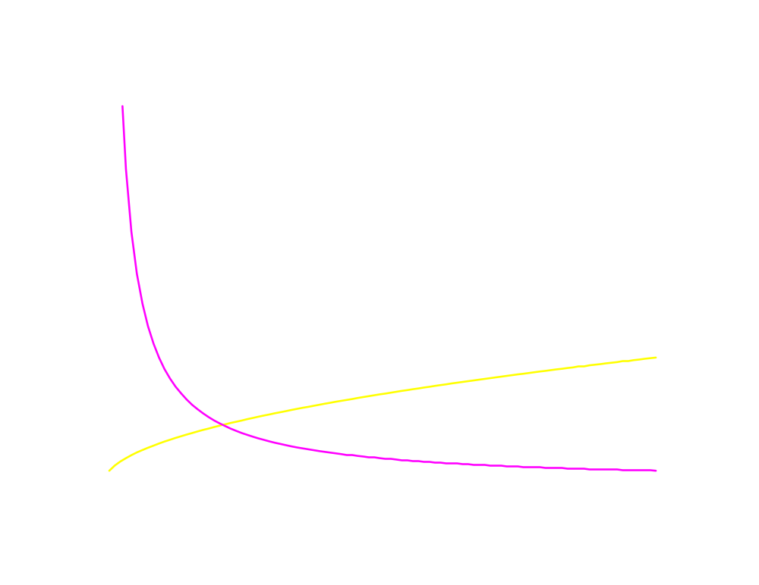
$/output unit
AVC(y)
AFC(y)
0
y

Slide 18
Av. Fixed, Av. Variable & Av. Total Cost Curves
And ATC(y) = AFC(y) + AVC(y)

Slide 19
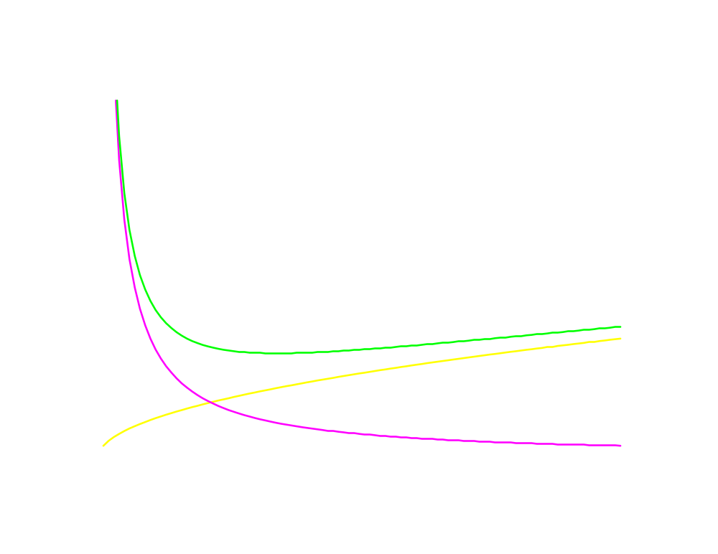
$/output unit
ATC(y) = AFC(y) + AVC(y)
ATC(y)
AVC(y)
AFC(y)
0
y

Slide 20
$/output unit
AFC(y) = ATC(y) - AVC(y)
ATC(y)
AFC
AVC(y)
AFC(y)
0
y

Slide 21
Since AFC(y) → 0 as y → ∞,
ATC(y) → AVC(y) as y → ∞.
$/output unit
ATC(y)
AFC
AVC(y)
AFC(y)
0
y

Slide 22
Since AFC(y) → 0 as y → ∞,
ATC(y) → AVC(y) as y → ∞.
$/output unit
And since short-run AVC(y) must
eventually increase, ATC(y) must
eventually increase in a short-run.
ATC(y)
AVC(y)
AFC(y)
0
y

Slide 23
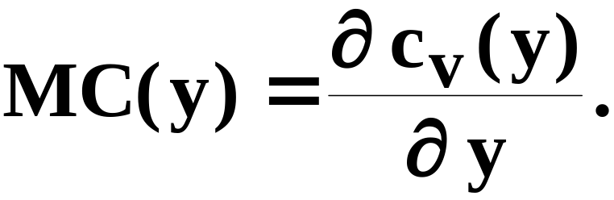
Marginal Cost Function
Marginal cost is the rate-of-change of variable production cost as the output level changes. That is,

Slide 24
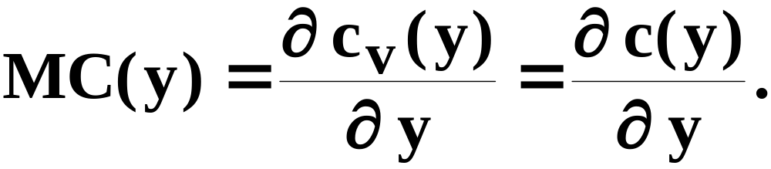
Marginal Cost Function
The firm’s total cost function is
and the fixed cost F does not change with the output level y, so
MC is the slope of both the variable cost and the total cost functions.

Slide 25
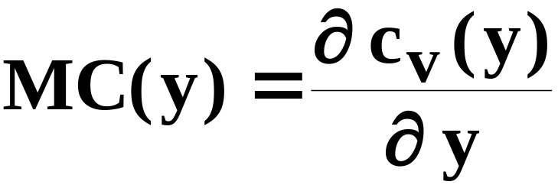
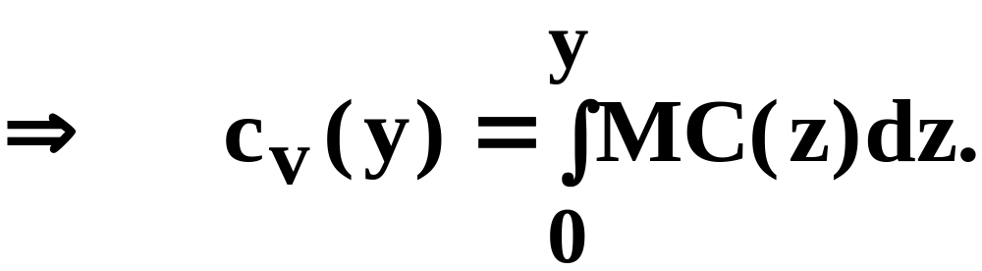
Marginal and Variable Cost Functions
Since MC(y) is the derivative of c_{v}(y), c_{v}(y) must be the integral of MC(y). That is,

Slide 26
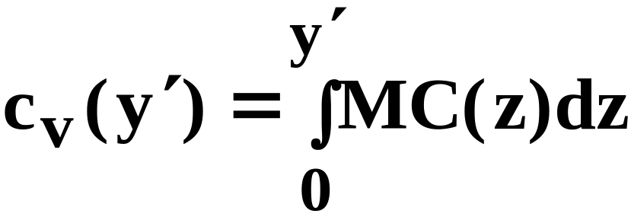

Marginal and Variable Cost Functions
$/output unit
MC(y)
Area is the variable
cost of making y’ units
0
y

Slide 27
Marginal & Average Cost Functions
How is marginal cost related to average variable cost?

Slide 28
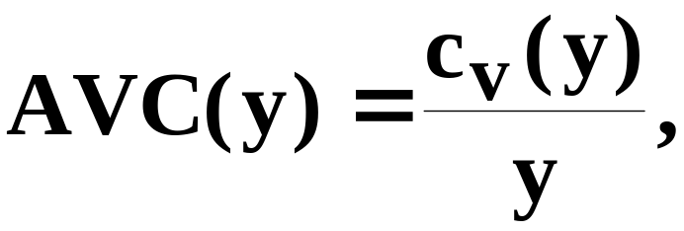
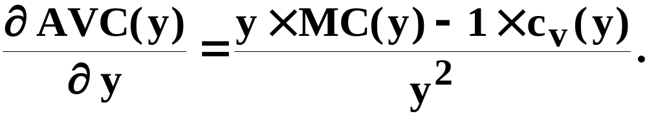
Marginal & Average Cost Functions
Since

Slide 29
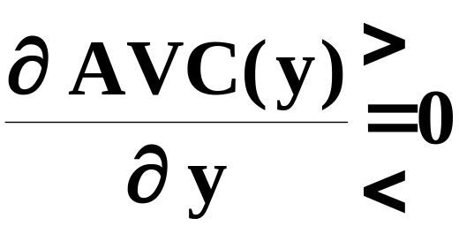
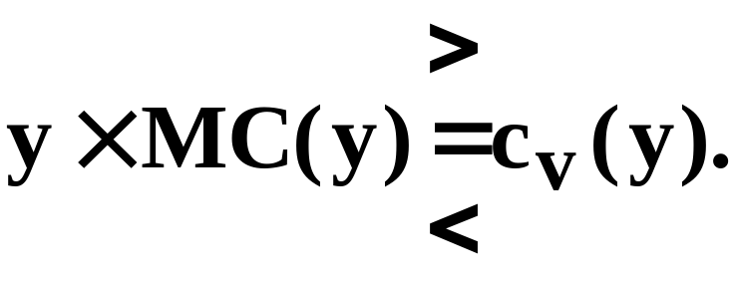
Marginal & Average Cost Functions
Since
Therefore,
as

Slide 30

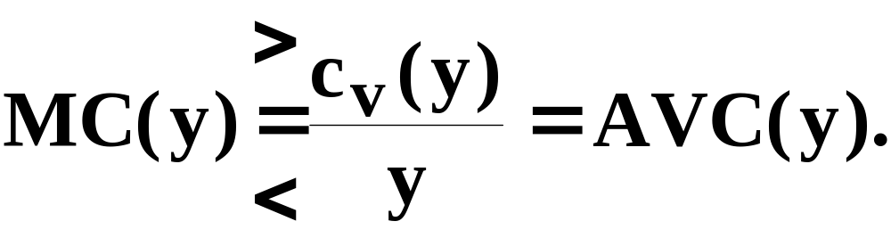
Marginal & Average Cost Functions
Since
Therefore,
as
as

Slide 31
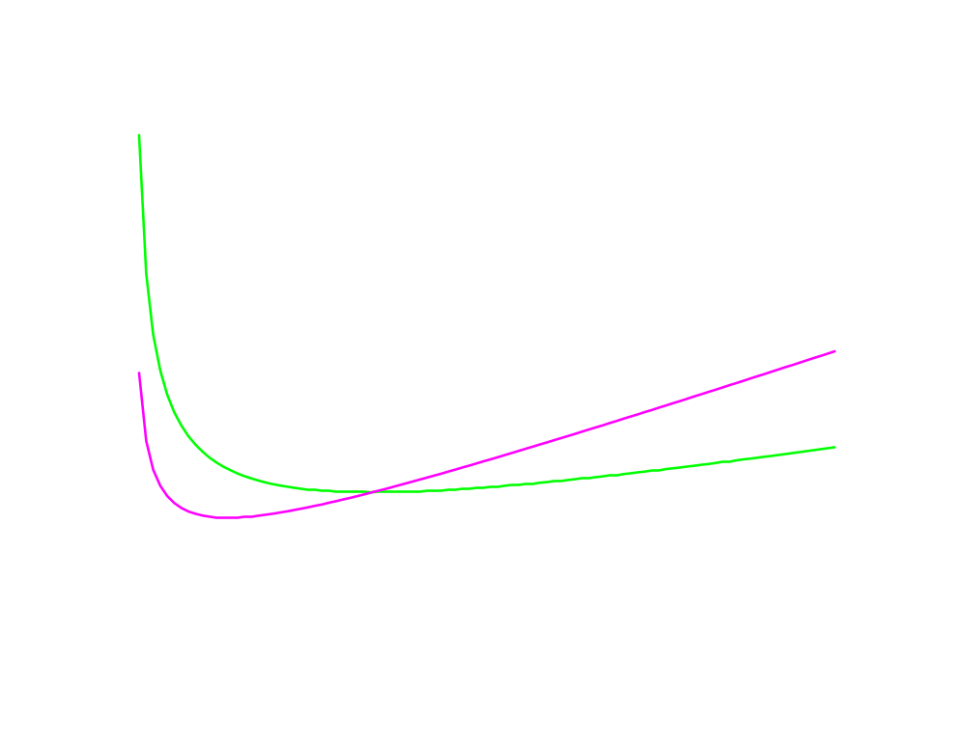
$/output unit
MC(y)
AVC(y)
y

Slide 32
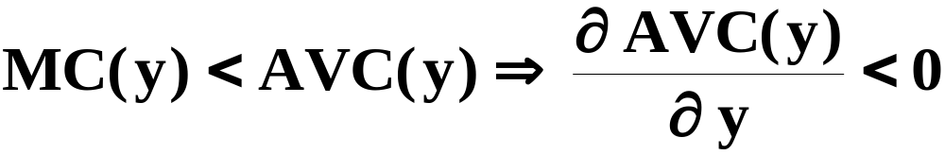
$/output unit
MC(y)
AVC(y)
y

Slide 33
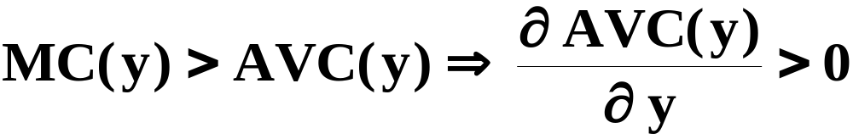
$/output unit
MC(y)
AVC(y)
y

Slide 34

$/output unit
MC(y)
AVC(y)
y

Slide 35
$/output unit
The short-run MC curve intersects
the short-run AVC curve from
below at the AVC curve’s
minimum.
MC(y)
AVC(y)
y

Slide 36
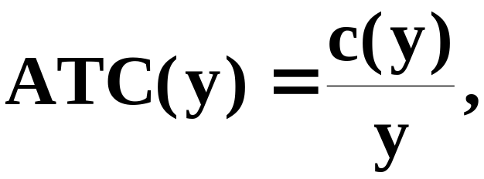
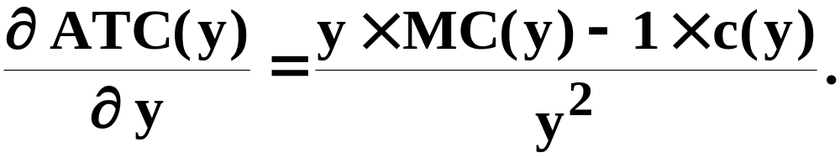
Marginal & Average Cost Functions
Similarly, since

Slide 37
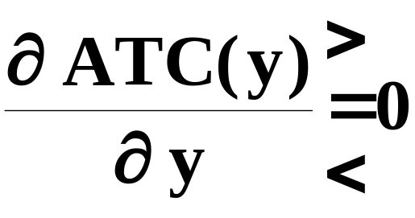
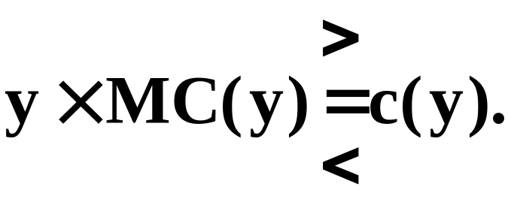
Marginal & Average Cost Functions
Similarly, since
Therefore,
as

Slide 38

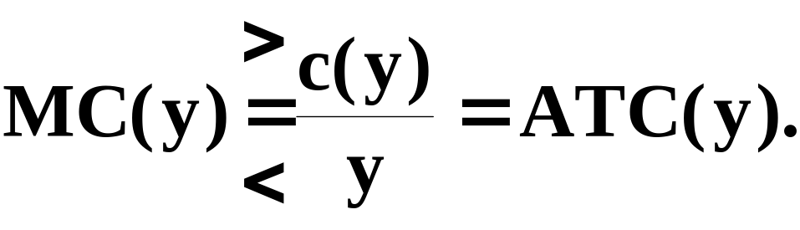
Marginal & Average Cost Functions
Similarly, since
Therefore,
as
as

Slide 39
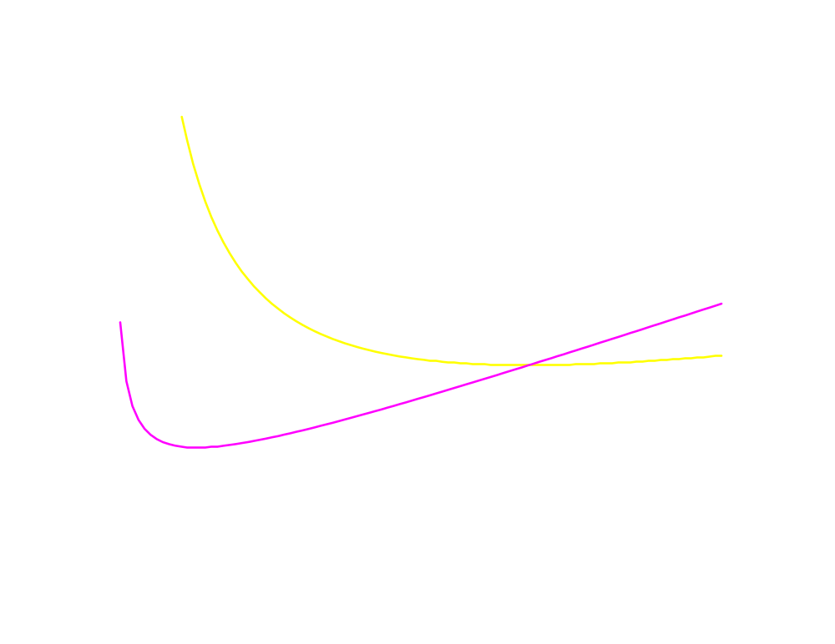
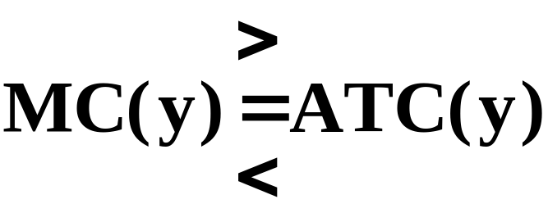
$/output unit
as
MC(y)
ATC(y)
y

Slide 40
Marginal & Average Cost Functions
The short-run MC curve intersects the short-run AVC curve from below at the AVC curve’s minimum.
And, similarly, the short-run MC curve intersects the short-run ATC curve from below at the ATC curve’s minimum.

Slide 41
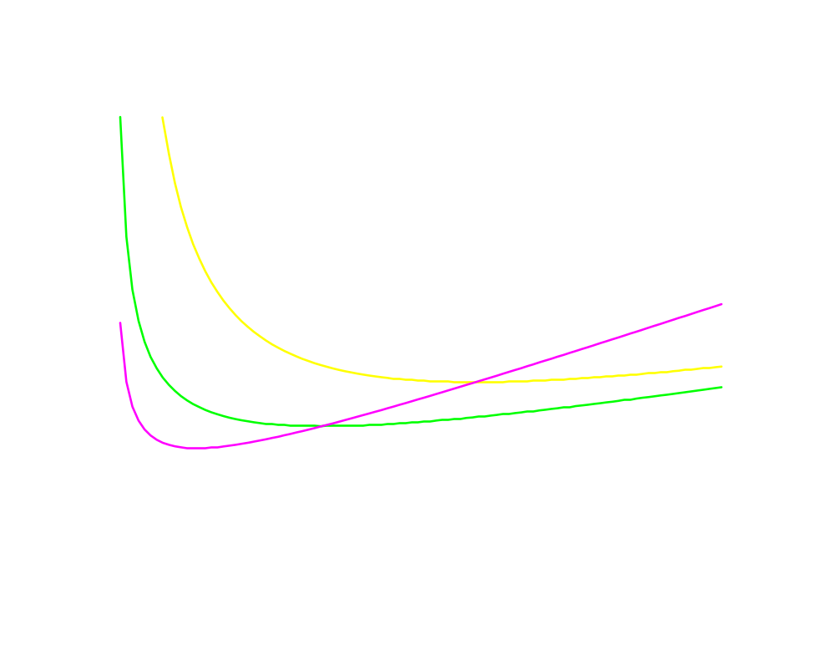
$/output unit
MC(y)
ATC(y)
AVC(y)
y

Slide 42
Short-Run & Long-Run Total Cost Curves
A firm has a different short-run total cost curve for each possible short-run circumstance.
Suppose the firm can be in one of just three short-runs;
x₂ = x₂′
or x₂ = x₂′′ x₂′ < x₂′′ < x₂′′′.
or x₂ = x₂′′′.

Slide 43
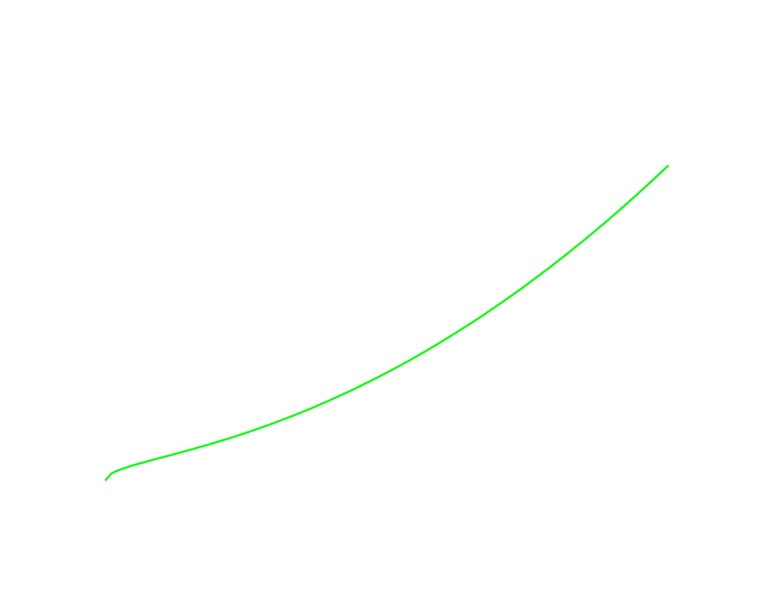
$
c_{s}(y;x₂′)
F′ = w₂x₂′
F′
0
y

Slide 44
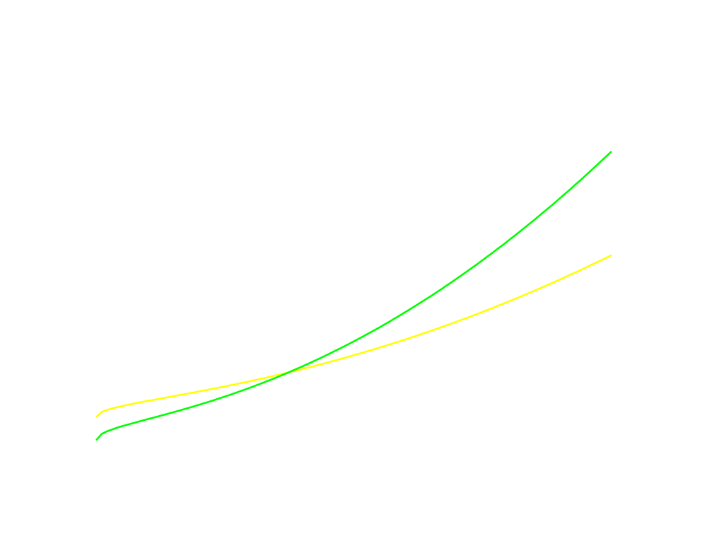
$
c_{s}(y;x₂′)
F′ = w₂x₂′
F′′ = w₂x₂′′
c_{s}(y;x₂′′)
F′′
F′
0
y

Slide 45
$
c_{s}(y;x₂′)
F′ = w₂x₂′
F′′ = w₂x₂′′
A larger amount of the fixed
input increases the firm’s
fixed cost.
c_{s}(y;x₂′′)
F′′
F′
0
y

Slide 46
$
c_{s}(y;x₂′)
F′ = w₂x₂′
F′′ = w₂x₂′′
A larger amount of the fixed
input increases the firm’s
fixed cost.
c_{s}(y;x₂′′)
Why does
a larger amount of
the fixed input reduce the slope of the firm’s total cost curve?
F′′
F′
0
y

Slide 47
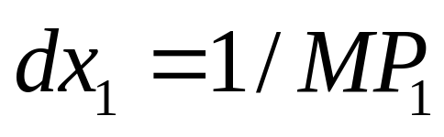
Short-Run & Long-Run Total Cost Curves
MP₁ is the marginal physical productivity
of the variable input 1 (MP₁=dy/dx₁), so one extra unit of input 1 gives MP₁ extra output units.
Therefore, the extra amount of input 1
needed for 1 extra output unit (dy=1) is
units of input 1.

Slide 48
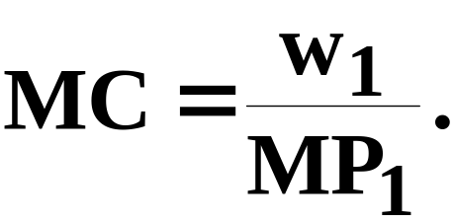
Short-Run & Long-Run Total Cost Curves
MP₁ is the marginal physical productivity
of the variable input 1 (MP₁=dy/dx₁), so one extra unit of input 1 gives MP₁ extra output units.
Therefore, the extra amount of input 1
needed for 1 extra output unit (dy=1) is
units of input 1.
Each unit of input 1 costs w₁, so the firm’s
extra cost from producing one extra unit
of output is

Slide 49
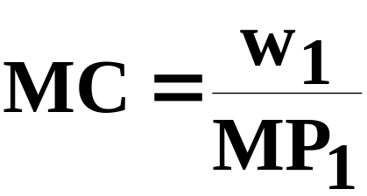
Short-Run & Long-Run Total Cost Curves
is the slope of the firm’s total cost curve.

Slide 50
Short-Run & Long-Run Total Cost Curves
is the slope of the firm’s total cost curve.
If input 2 is a complement to input 1 then
MP₁ is higher for higher x₂.
Hence, MC is lower for higher x₂.
That is, a short-run total cost curve starts
higher and has a lower slope if x₂ is larger.

Slide 51
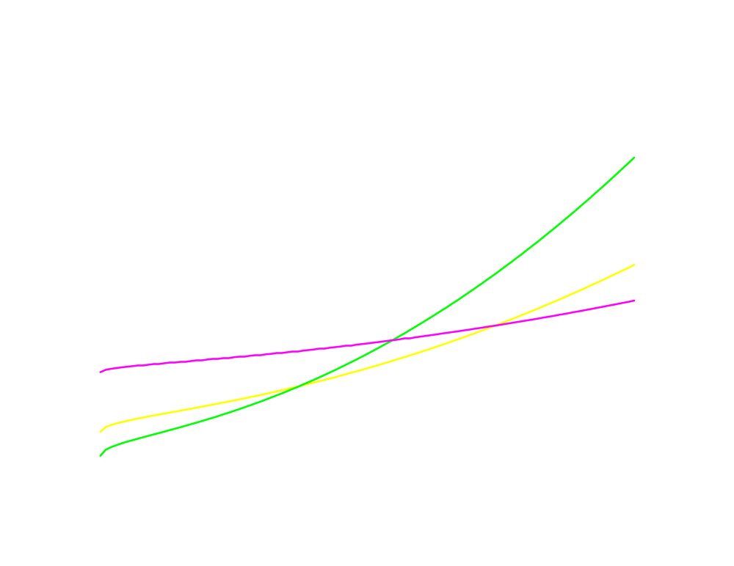
$
c_{s}(y;x₂′)
F′ = w₂x₂′
F′′ = w₂x₂′′
F′′′ = w₂x₂′′′
c_{s}(y;x₂′′)
c_{s}(y;x₂′′′)
F′′′
F′′
F′
0
y

Slide 52
Short-Run & Long-Run Total Cost Curves
The firm has three short-run total cost curves.
In the long-run the firm is free to choose amongst these three since it is free to select x₂ equal to any of x₂′, x₂′′, or x₂′′′.
How does the firm make this choice?

Slide 53
$
For 0 ≤ y ≤ y′, choose x₂ = x₂′.
c_{s}(y;x₂′)
c_{s}(y;x₂′′)
c_{s}(y;x₂′′′)
F′′′
F′′
F′
0
y′
y′′
y

Slide 54
$
For 0 ≤ y ≤ y′, choose x₂ = x₂′.
c_{s}(y;x₂′)
For y′ ≤ y ≤ y′′, choose x₂ = x₂′′.
c_{s}(y;x₂′′)
c_{s}(y;x₂′′′)
F′′′
F′′
F′
0
y′
y′′
y

Slide 55
$
For 0 ≤ y ≤ y′, choose x₂ = x₂′.
c_{s}(y;x₂′)
For y′ ≤ y ≤ y′′, choose x₂ = x₂′′.
For y′′ < y, choose x₂ = x₂′′′.
c_{s}(y;x₂′′)
c_{s}(y;x₂′′′)
F′′′
F′′
F′
0
y′
y′′
y

Slide 56
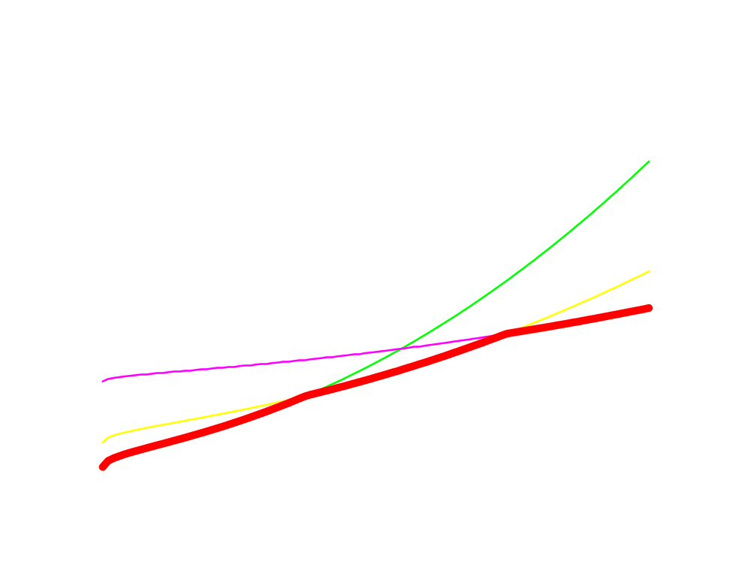
$
For 0 ≤ y ≤ y′, choose x₂ = x₂′.
c_{s}(y;x₂′)
For y′ ≤ y ≤ y′′, choose x₂ = x₂′′.
For y′′ < y, choose x₂ = x₂′′′.
c_{s}(y;x₂′′)
c_{s}(y;x₂′′′)
c(y), the
firm’s long-
run total
cost curve.
F′′′
F′′
F′
0
y′
y′′
y

Slide 57
Short-Run & Long-Run Total Cost Curves
The firm’s long-run total cost curve consists of the lowest parts of the short-run total cost curves. The long-run total cost curve is the lower envelope of the short-run total cost curves.

Slide 58
Short-Run & Long-Run Total Cost Curves
If input 2 is available in continuous amounts then there is an infinity of short-run total cost curves but the long-run total cost curve is still the lower envelope of all of the short-run total cost curves.

Slide 59
$
c_{s}(y;x₂′)
c_{s}(y;x₂′′)
c_{s}(y;x₂′′′)
c(y)
F′′′
F′′
F′
0
y

Slide 60
Short-Run & Long-Run Average Total Cost Curves
For any output level y, the long-run total cost curve always gives the lowest possible total production cost.
Therefore, the long-run average total cost curve must always give the lowest possible average total production cost.
The long-run av. total cost curve must be the lower envelope of all of the firm’s short-run av. total cost curves.

Slide 61
Short-Run & Long-Run Average Total Cost Curves
E.g. suppose again that the firm can be in one of just three short-runs;
x₂ = x₂′
or x₂ = x₂′′ (x₂′ < x₂′′ < x₂′′′)
or x₂ = x₂′′′
then the firm’s three short-run average total cost curves are ...

Slide 62
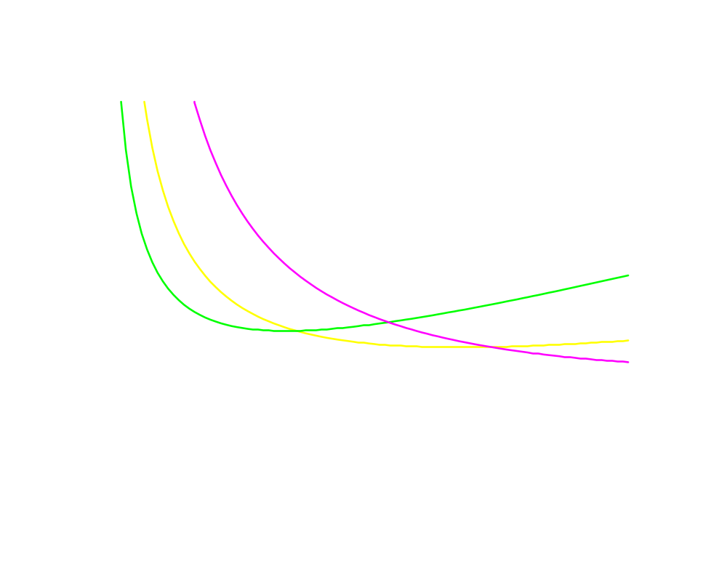
$/output unit
AC_{s}(y;x₂′)
AC_{s}(y;x₂′′)
AC_{s}(y;x₂′′′)
y

Slide 63
Short-Run & Long-Run Average Total Cost Curves
The firm’s long-run average total cost curve is the lower envelope of the short-run average total cost curves ...

Slide 64
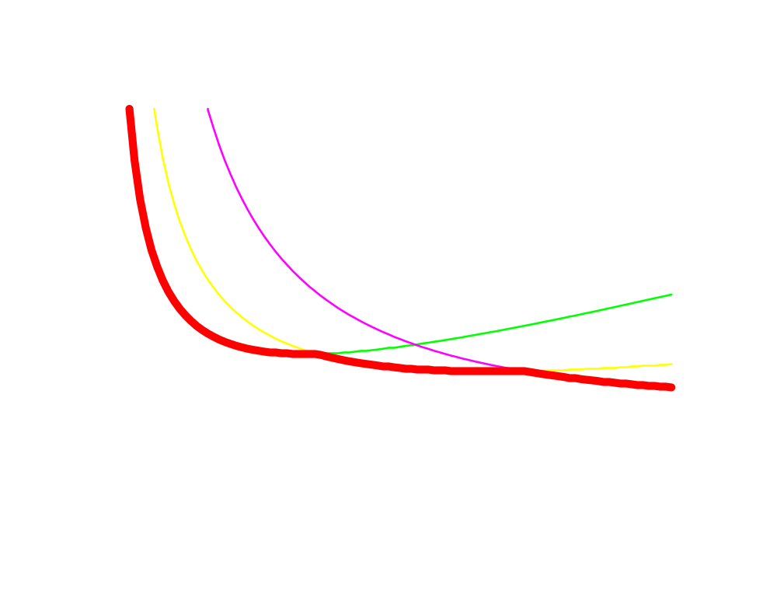
$/output unit
AC_{s}(y;x₂′′′)
AC_{s}(y;x₂′)
AC_{s}(y;x₂′′)
The long-run av. total cost
curve is the lower envelope
of the short-run av. total cost curves.
AC(y)
y

Slide 65
Short-Run & Long-Run Marginal Cost Curves
Q: Is the long-run marginal cost curve the lower envelope of the firm’s short-run marginal cost curves?

Slide 66
Short-Run & Long-Run Marginal Cost Curves
Q: Is the long-run marginal cost curve the lower envelope of the firm’s short-run marginal cost curves?
A: No.

Slide 67
Short-Run & Long-Run Marginal Cost Curves
The firm’s three short-run average total cost curves are ...

Slide 68
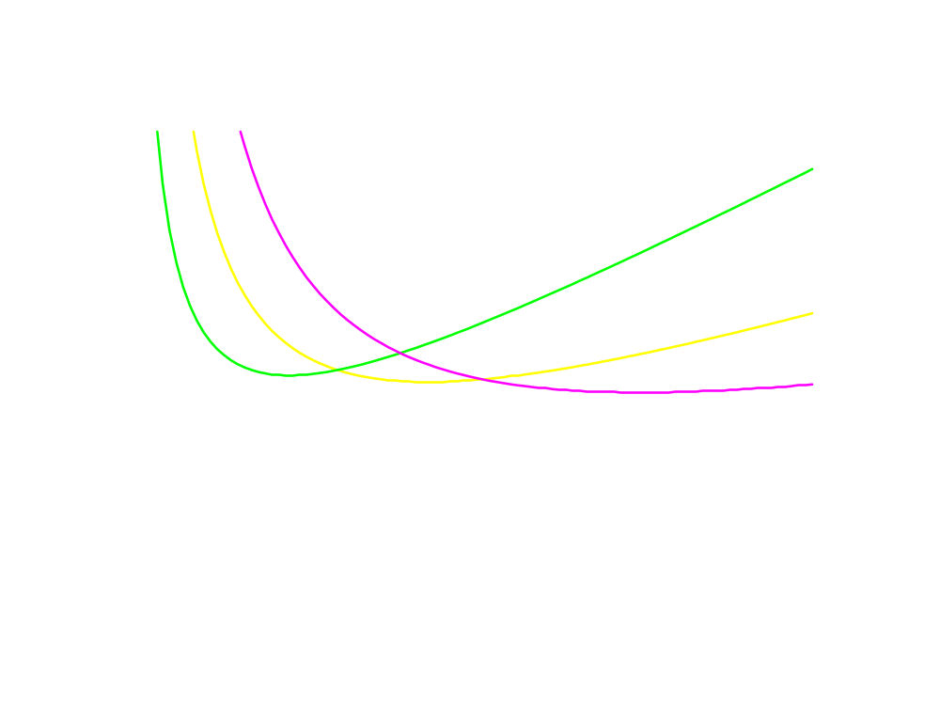
$/output unit
AC_{s}(y;x₂′′′)
AC_{s}(y;x₂′)
AC_{s}(y;x₂′′)
y

Slide 69
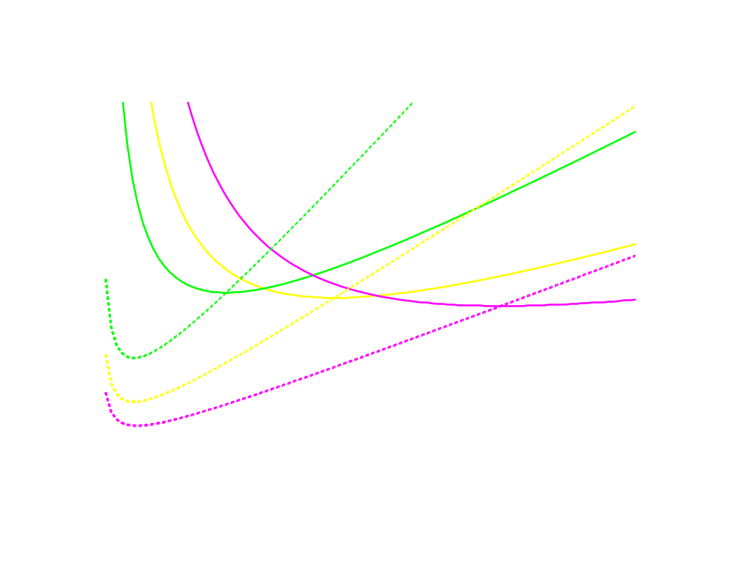
$/output unit
MC_{s}(y;x₂′)
MC_{s}(y;x₂′′)
AC_{s}(y;x₂′′′)
AC_{s}(y;x₂′)
AC_{s}(y;x₂′′)
MC_{s}(y;x₂′′′)
y

Slide 70
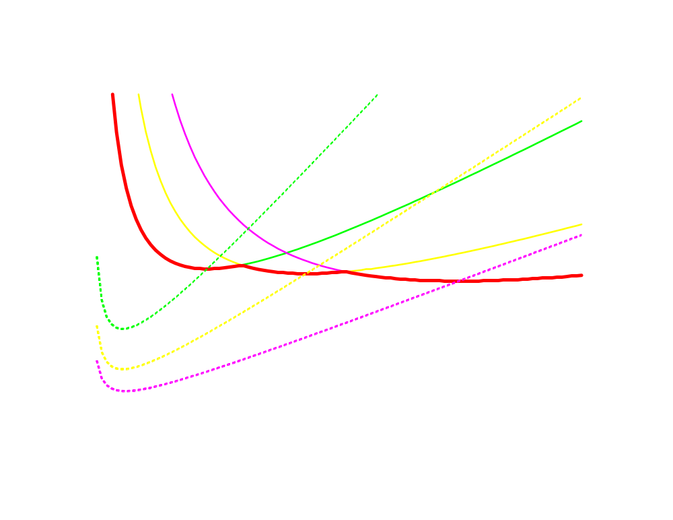
$/output unit
MC_{s}(y;x₂′)
MC_{s}(y;x₂′′)
AC_{s}(y;x₂′′′)
AC_{s}(y;x₂′)
AC_{s}(y;x₂′′)
AC(y)
MC_{s}(y;x₂′′′)
y

Slide 71
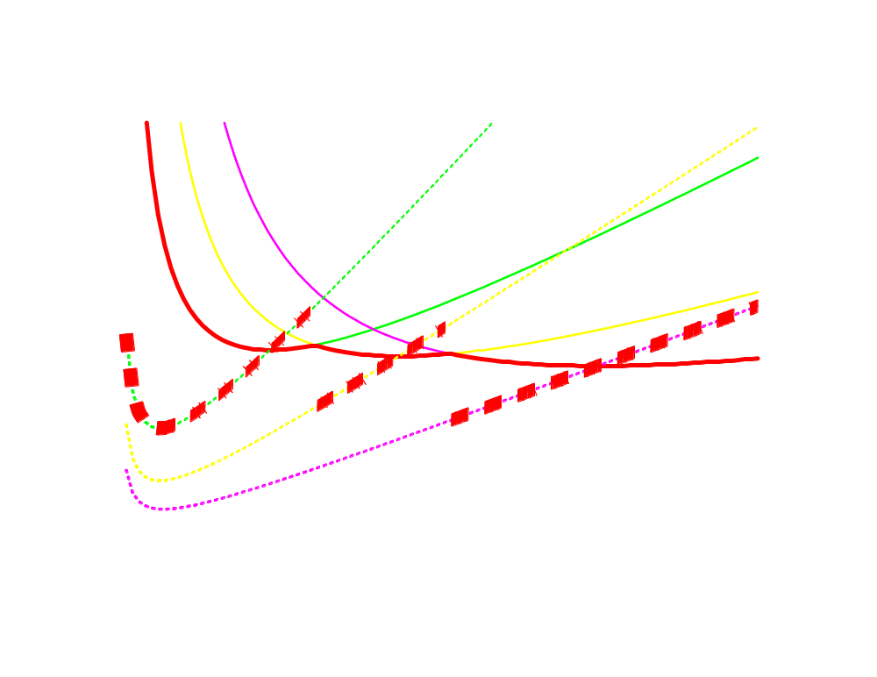
$/output unit
MC_{s}(y;x₂′)
MC_{s}(y;x₂′′)
AC_{s}(y;x₂′′′)
AC_{s}(y;x₂′)
AC_{s}(y;x₂′′)
AC(y)
MC_{s}(y;x₂′′′)
y

Slide 72
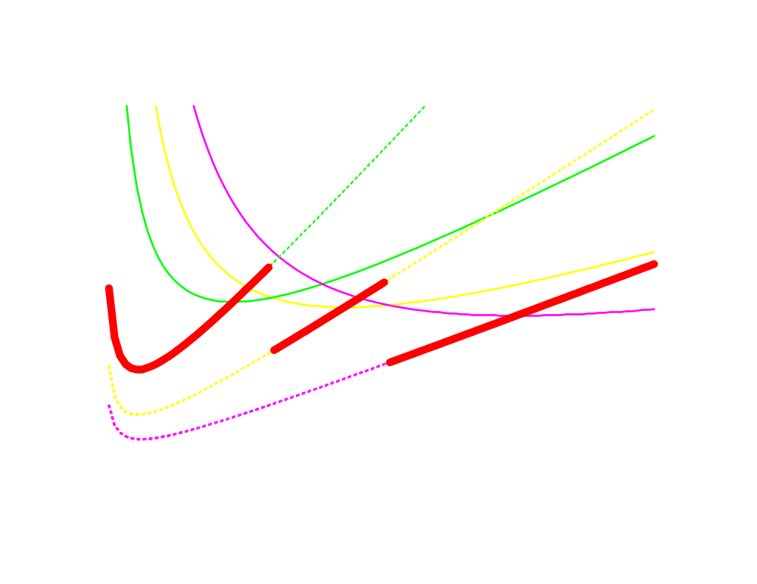
$/output unit
MC_{s}(y;x₂′)
MC_{s}(y;x₂′′)
AC_{s}(y;x₂′′′)
AC_{s}(y;x₂′)
AC_{s}(y;x₂′′)
MC_{s}(y;x₂′′′)
MC(y), the long-run marginal
cost curve.
y

Slide 73
Short-Run & Long-Run Marginal Cost Curves
For any output level y > 0, the long-run marginal cost of production equals to the short-run marginal cost chosen by the firm.

Slide 74
A Short-Run Chosen by the Firm
For the continuous case, where x₂ can be fixed at any value --
At an output y*
Chosen input: x₂* = x₂(y * )
and fix it to get a short run.
At this x₂* : c(y*)=c_{s}(y*, x₂*)
Accordingly,
    AC(y*)=AC_{s}(y*, x₂*)
    MC(y*)=MC_{s}(y*, x₂*)

Slide 75
Short-Run & Long-Run Total Costs
$
c_{s}(y)
c(y)
y*
y

Slide 76
Short-Run & Long-Run Marginal Cost Curves
$/output unit
SRACs
AC(y)
y

Slide 77
Short-Run & Long-Run Marginal Cost Curves
$/output unit
SRMCs
AC(y)
y

Slide 78
Short-Run & Long-Run Marginal Cost Curves
$/output unit
MC(y)
SRMCs
AC(y)
y
For each y > 0, the long-run MC equals the
MC for the short-run chosen by the firm.

